Slide 1


Introduction to Cybersecurity
Cyber Lab Preparation
ILIA STATE UNIVERSITY
Paata Gogishvili
Doctor of Informatics
Associate Professor
School of Technology
April 2, 2023
Faculty of Business, Technology and Education

Slide 2
Lecture Topics
Introduction To Virtual Cyber Lab Environment
Installing The VirtualBox
Preparing The NatNetwork
Installing The Kali Linux
Installing The Metasploitable2
ILIA STATE UNIVERSITY

Slide 3
Cybersecurity Lab Setup
Practical training is necessary to learn hacking methods. You probably remember that hacking is only legal if we do it either on our own infrastructure or with the written permission of the owner. In order to stay within the law, a convenient solution is to prepare a virtual cyber security lab.
A cyber security lab can be set up entirely in a virtual environment while still accurately mirroring the physical environment. Therefore, all the experiments conducted in the virtual environment will be valid on the real infrastructure as well.
ILIA STATE UNIVERSITY

Slide 4
Cybersecurity Lab Setup
The virtual laboratory can be placed entirely on our computer. For this, install VirtualBox on the computer.
VirtualBox is a free and open-source virtualization software developed by Oracle. It allows you to run multiple virtual machines (VMs) on a single physical computer. Each virtual machine acts as an independent, self-contained computer with its own operating system and software.
We will create virtual computers and appropriate network infrastructure within the VirtualBox.
ILIA STATE UNIVERSITY

Slide 5
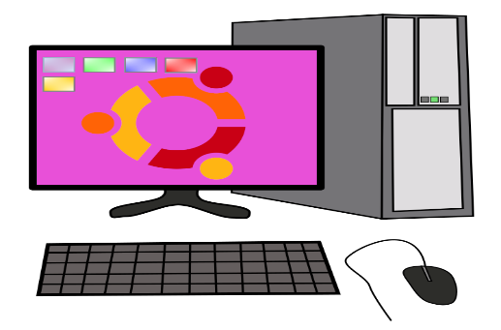
Cybersecurity Lab Setup
ILIA STATE UNIVERSITY

Slide 6

Cybersecurity Lab Setup
ILIA STATE UNIVERSITY

Slide 7

Cybersecurity Lab Setup
ILIA STATE UNIVERSITY

Slide 8

Cybersecurity Lab Setup
ILIA STATE UNIVERSITY

Slide 9

Cybersecurity Lab Setup
ILIA STATE UNIVERSITY

Slide 10
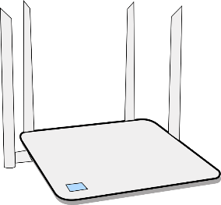
Lab Computers Will be Isolated
ILIA STATE UNIVERSITY
NatNetwork

